Slide 1
Arrays and User-defined data types in C

Slide 2
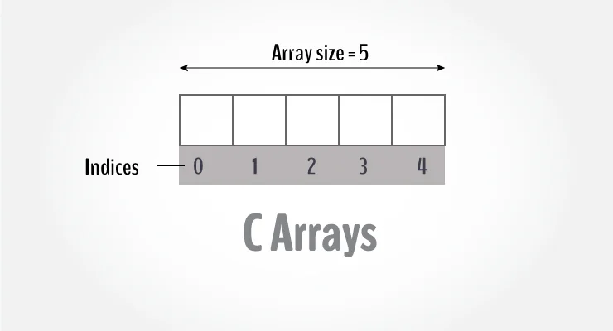
C Arrays
Arrays are used to store a fixed-size sequential collection of elements of the same type.
To declare an array in C, specifies the type of the elements and the number of elements required by an array.
type arrayName [ arraySize ];
For example, if you want to store 100 integers, you can
create an array for it.
int data[100];
The size and type of an array cannot be changed once
it is declared.

Slide 3
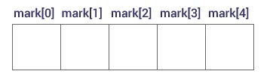
Access Array Elements
You can access elements of an array by indices.
The first element is mark[0], the second element is mark[1] and so on.
Arrays have 0 as the first index, not 1.
If the size of an array is n, to access the last element, the n-1 index is used.

Slide 4
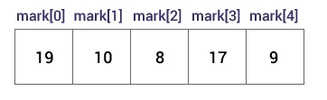
How to initialize an array?
C++ array elements can be initialized either one by one or using a single statement as follows:
int mark[5] = {19, 10, 8, 17, 9};
Or:
int mark[5];
mark[0] = 19;
mark[1] = 10;
If you omit the size of the array, an array just big enough to hold the initialization is created.
int mark[] = {19, 10, 8, 17, 9};

Slide 5
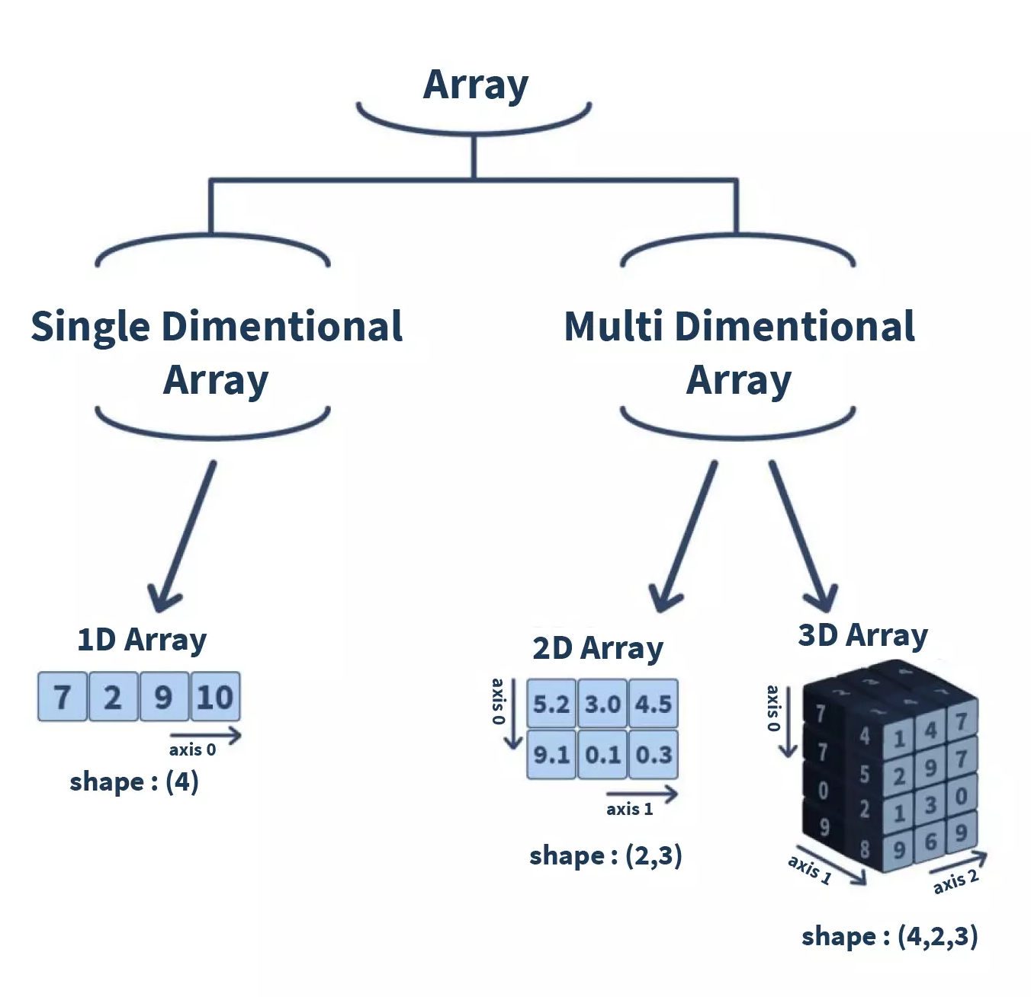
Types of array
Array is a collection of similar types of data present in the contiguous memory location. It is divided into two basic types: single-dimensional(1D and multi-dimensional Array. The multi-dimensional arrays can be further divided into two-dimensional (2-D), three-dimensional (3-D), and n-dimensional (N-D) arrays.

Slide 6
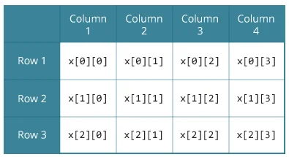
C Multidimensional Arrays
You can create an array of arrays. These arrays are
known as multidimensional arrays.
For example,
float x[3][4];
Here, x is a two-dimensional (2d) array.
The array can hold 12 elements.
It is a table with 3 rows and each row has 4 columns.

Slide 7
Initializing a multidimensional array
Initialization of a 2d array
// Different ways to initialize a two-dimensional array
int c[2][3] = {{1, 3, 0}, {-1, 5, 9}};
int c[][3] = {{1, 3, 0}, {-1, 5, 9}};
int c[2][3] = {1, 3, 0, -1, 5, 9};

Slide 8
Initializing a multidimensional array
Initialization of a 3d array
int test[2][3][4] = {
{{3, 4, 2, 3}, {0, -3, 9, 11}, {23, 12, 23, 2}},
{{13, 4, 56, 3}, {5, 9, 3, 5}, {3, 1, 4, 9}}};

Slide 9
Properties of Array
The array contains the following properties.
Each element of an array is of same data type and carries the same size, i.e., int = 4 bytes.
Elements of the array are stored at contiguous memory locations where the first element is stored at the smallest memory location.
Elements of the array can be randomly accessed since we can calculate the address of each element of the array with the given base address and the size of the data element.

Slide 10
Advantage of C Array
1) Code Optimization: Less code to the access the data.
2) Ease of traversing: By using the for loop, we can retrieve the elements of an array easily.
3) Ease of sorting: To sort the elements of the array, we need a few lines of code only.
4) Random Access: We can access any element randomly using the array.
Disadvantage of C Array
1) Fixed Size: Whatever size, we define at the time of declaration of the array, we can't exceed the limit. So, it doesn't grow the size dynamically like LinkedList which we will learn later.

Slide 11
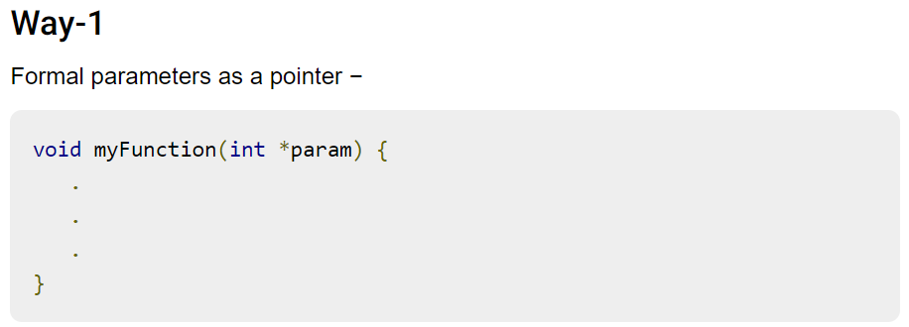
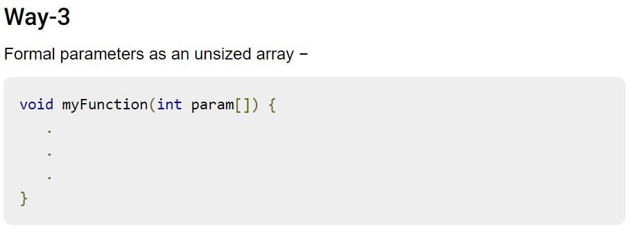
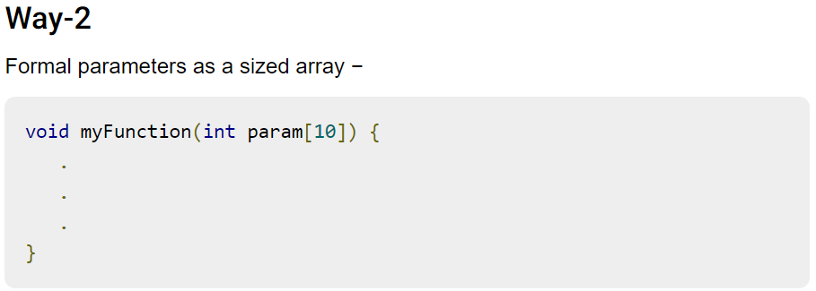
Passing arrays to functions
Just like normal variables, Arrays can also be passed to a function as an argument, but in C whenever we pass an array as a function argument then it is always treated as a pointer by a function. Pointers not only have the capability of storing the address of a single variable but they can also store the address of cells of an array.

Slide 12
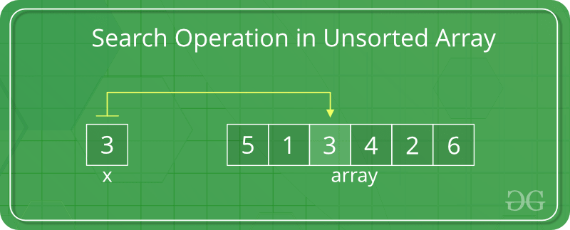
Search Operation in an array
In an unsorted array, the search operation can be performed by linear traversal from the first element to the last element.
// Function to implement search operation
int findElement(int arr[], int n, int key)
{
int i;
for (i = 0; i < n; i++)
if (arr[i] == key)
return i;
// If the key is not found
return -1;
}

Slide 13
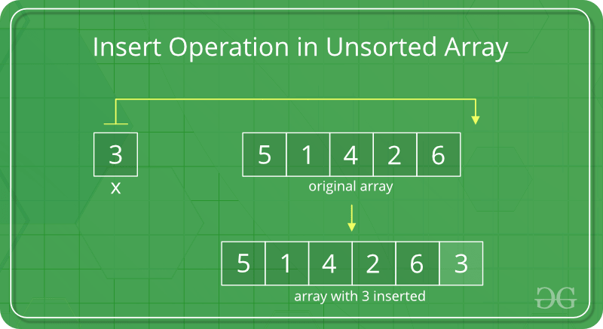
Insert elements to an array
Elements can be inserted to an array in two ways.
Insert at the end of the list
Insert at any position
Insert at the end:
In an unsorted array, the insert operation is faster as compared to a sorted array because we don’t have to care about the position at which the element is to be placed.

Slide 14
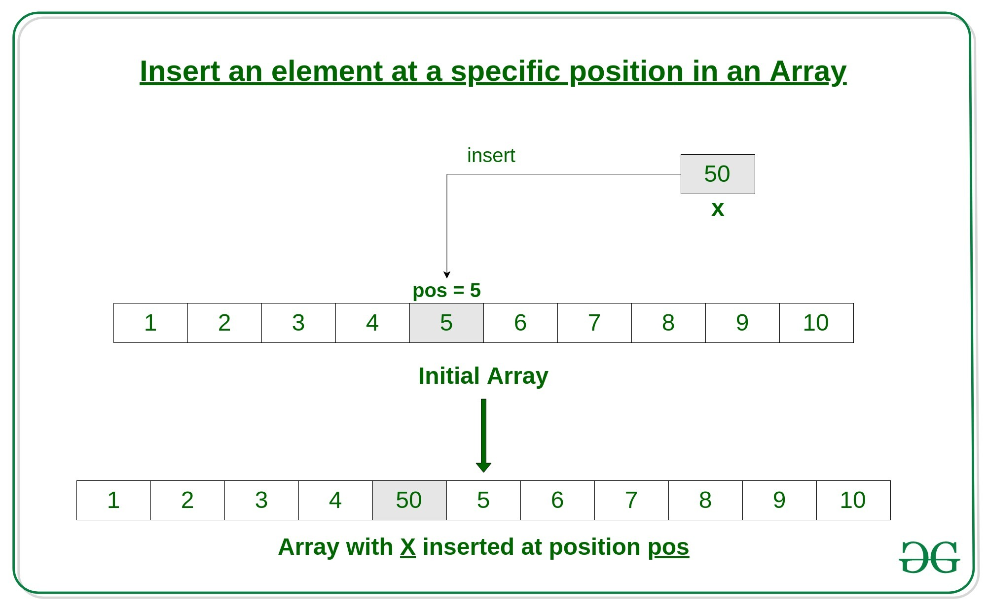
Insert at any position
Insert operation in an array at any position can be performed by shifting elements to the right, which are on the right side of the required position

Slide 15
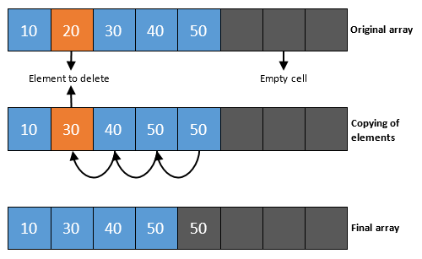
Remove an element from an array in C
To delete a specific element from an array, a user must define the position from which the array's element should be removed. The deletion of the element does not affect the size of an array.

Slide 16
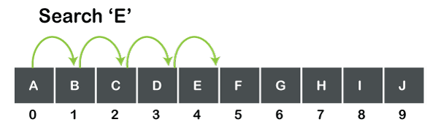
Linear search in C
A linear search is also known as a sequential search that simply scans each element at a time.
f we want to search 'E', then the searching begins from the 0th element and scans each element until the element, i.e., 'E' is not found. We cannot directly jump from the 0th element to the 4th element, i.e., each element is scanned one by one till the element is not found.
Complexity of Linear search
As linear search scans each element one by one until the element is not found. If the number of elements increases, the number of elements to be scanned is also increased. We can say that the time taken to search the elements is proportional to the number of elements.

Slide 17
Binary search in C
A binary search is a search in which the middle element is calculated to check whether it is smaller or larger than the element which is to be searched.
The main advantage of using binary search is that it does not scan each element in the list. Instead of scanning each element, it performs the searching to the half of the list. So, the binary search takes less time to search an element as compared to a linear search.
The one pre-requisite of binary search is that an array should be in sorted order, whereas the linear search works on both sorted and unsorted array.
The binary search algorithm is based on the divide and conquer technique, which means that it will divide the array recursively.

Slide 18
Approach for Binary Search
Compare the target element with the middle element of the array.
If the target element is greater than the middle element, then the search continues in the right half.
Else if the target element is less than the middle value, the search continues in the left half.
This process is repeated until the middle element is equal to the target element, or the target element is not in the array
If the target element is found, its index is returned, else -1 is returned.

Slide 19
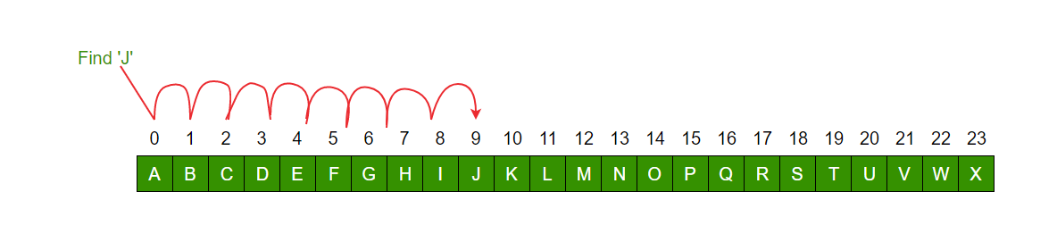
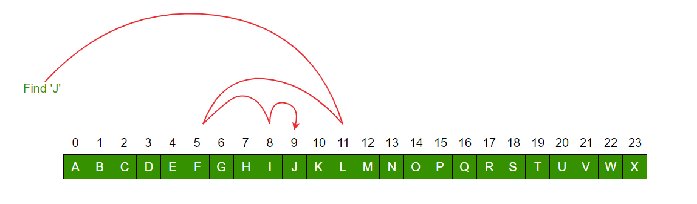
Linear search Vs Binary search
Linear search
Binary search

Slide 20
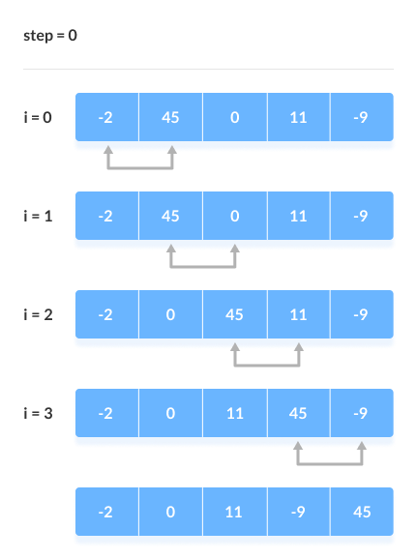
Sorting of array using bubble sort in C
Bubble sort is a sorting algorithm that compares two adjacent elements and swaps them until they are in the intended order.
Just like the movement of air bubbles in the water that rise up to the surface, each element of the array move to the end in each iteration. Therefore, it is called a bubble sort.
Working of Bubble Sort
Suppose we are trying to sort the elements in ascending order.
1. First Iteration (Compare and Swap)
Starting from the first index, compare the first and the second elements.
If the first element is greater than the second element, they are swapped.
Now, compare the second and the third elements. Swap them if they are not in order.
The above process goes on until the last element.

Slide 21
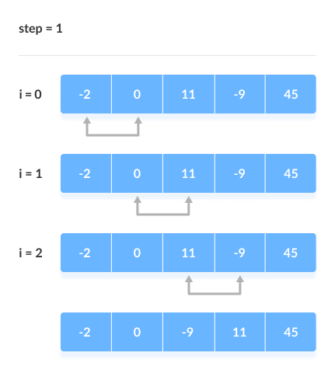
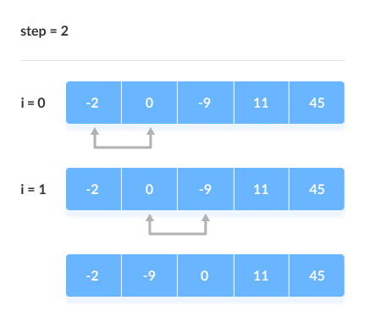
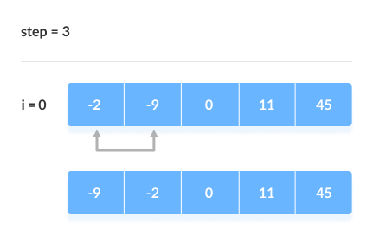
Working of Bubble Sort
2. Remaining Iteration
The same process goes on for the remaining iterations.
After each iteration, the largest element among the unsorted elements is placed at the end.

Slide 22
User defined data types
C allows the type definition feature, which allows programmers to define their identifier representing an existing data type.
There are three such types:
Data Types | Description
Structure | It is a package of variables of different types under the same name. This is done to handle the data efficiently. Here the "struct" keyword is used to define a structure.
Union | These allow storing various data types in the same memory location. Programmers can define a union with different members, but only a single member can contain a value at a given time.
Enum | Enumeration is a special data type that consists of integral constants. Each of them is assigned a specific name. "enum" keyword is used to define the enumerated data type.

Slide 23
#include<stdio.h> int main(){ printf(“Thank you\n”); return 0; }

